Slide 1
Capstone Project
What factors are most important in determining whether a patient is likely to suffer from a heart attack?
Omar Imambaccus
August, 2018

Slide 2
Outline
Problem Identification
Understanding the dataset
Data Wrangling Process
What story does the data tell us?
Inferential Statistics
Supervised Machine Learning
Limitations and Recommendations

Slide 3
Problem Identification

Slide 4
Problem Identification
Problem:
Misallocation of resources in the Canadian health sector. Not being able to cater to cardiac patients in need of urgent care.
Client:
Medical professionals in the health sector
Task:
Identifying what health related factors are the strongest predictors of whether a patient is likely to have a heart attack
Data:
UCI Machine Learning Repository/Heart Disease Dataset

Slide 5
Understanding the Dataset

Slide 6
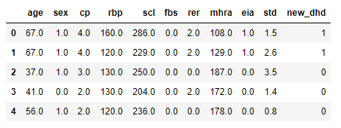
A look at the dataset
Independent Variables
Age of the patient
Gender of the patient
Chest Pain Type
Resting Blood Pressure
Serum Cholesterol Levels
Fasting Blood Sugar
Resting
Electrocardiographic
Results
Maximum
Heartrate
Achieved
(under stress)
Exercise Induced Angina
ST Depression
Target (Dependent) Variable
Greater or less than 50%
of major vessel blocked [0,1]
Greater than 50% means patient is more likely to suffer from a heart attack.

Slide 7
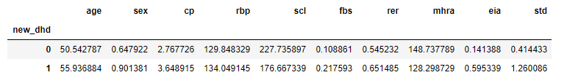
Grouping the dataset by target variable
In the table above, we published the mean of every variable after grouping the dataset by the target variable.

Slide 8
Data Wrangling Process

Slide 9
Data Wrangling
Dataset Description
4 processed datasets from Cleveland, Long Beach, Hungary and Switzerland
Dataset is cross-sectional from 1988
15 explanatory variables with 916 observations in total
Dealing with missing (NaN) values
Missing values denoted by ‘-9’ or ‘?’ entries
Did not delete rows with NaN values initially for exploratory analysis
Will need to delete rows for supervised learning analysis
Dropping Variables
Variables that had 50% or more of the data missing were dropped
These variables do not add value to analysis
Dataset now has 11 explanatory variables

Slide 10
What story does the data tell us?

Slide 11
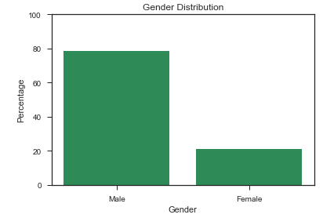
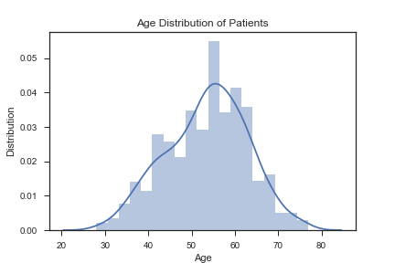
Patient Age Distribution
Gender Distribution
Most of patients are between the ages of 55-60 years old.
80% of patients in our analysis are males.

Slide 12
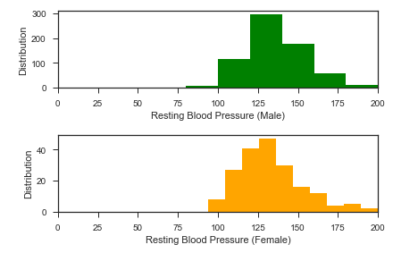
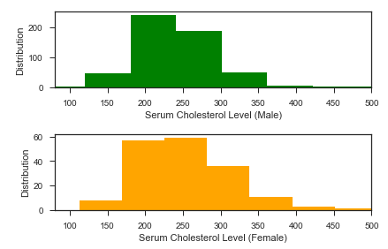
Serum Cholesterol Levels and Resting Blood Pressure | Gender Analysis
On average, male and female patients have the same average cholesterol levels and resting blood pressure.

Slide 13
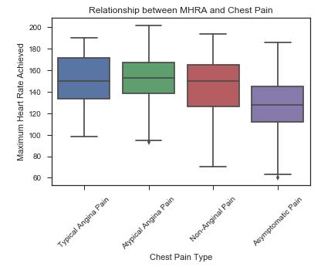
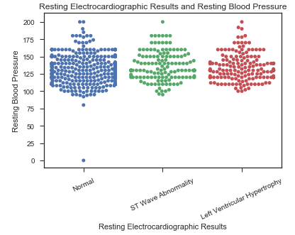
Chest Pain and Maximum Heart Rate
RER and Resting Blood Pressure
Patients that exhibited asymptomatic chest pains were not able to reach high maximum heart rate levels when put under stress.
Most patients had normal RER readings, while the height of each plot shows that the range of resting blood pressure is roughly the same across all patients.

Slide 14
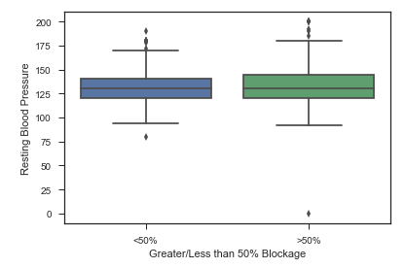
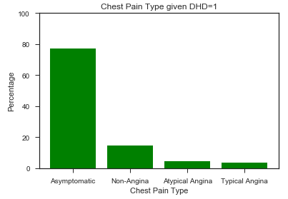
Analysis of Target Variable: Predicting whether a patient will have a heart attack (DHD)
Patients with more than 50% or less than 50% of their major vessels blocked had the same average resting blood pressure.
Patients that had more than 50% of their vessels blocked mostly suffered from asymptomatic chest pains.

Slide 15
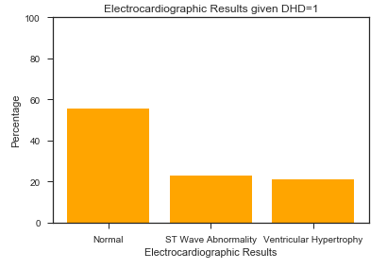
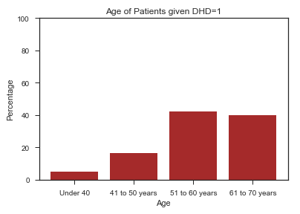
Most patients with major blockage in their vessels had normal electrocardiographic readings.
Patients that had more than 50% of their vessels blocked were mostly between the ages of 51-70 years old.

Slide 16
Inferential Statistics

Slide 17
In this section, we tested the null hypothesis that the mean of two different sample populations were the same.
We did this to identify whether certain variables add value to our analysis and draw conclusions about their respective means. Below are some examples:
High Resting Blood Pressure v Low Resting Blood Pressure
Firstly, we separated the dataset into two sample groups, those with high and low blood pressures.
We tested whether the null hypothesis was true: the mean that they would have a major blockage/minor blockage was the same across both samples
We reject this null hypothesis – the means of both samples are different
test statistic | p-value
3.43 | 0.0006
Normal v Abnormal Resting Electrocardiographic Results
Firstly, we separated the dataset into two sample groups, those with normal and abnormal RER readings
We tested whether the null hypothesis was true: the mean that they would have a major blockage/minor blockage was the same across both samples
We reject this null hypothesis – the means of both samples are different
test statistic | p-value
-2.98 | 0.002

Slide 18
Supervised Machine Learning

Slide 19
Model: Logistic Regression Model
We began our analysis by using a logistic regression model to predict our results. Below are the coefficients of our analysis:
Variable | Coefficient | Standard Error | Odds Ratio
Age | 0.003 | 9.394 | 1.002
Sex | 1.108 | 0.425 | 3.023
Chest Pain | 0.542 | 0.935 | 1.720
Resting BP | 0.003 | 18.597 | 1.003
Serum Cholesterol | -0.002 | 93.694 | 0.998
Fasting Blood Sugar | 0.404 | 0.356 | 1.499
Resting Electrocardiographic Results | 0.277 | 0.839 | 1.32
Maximum Heart Rate | -0.02 | 25.830 | 0.981
Exercise Induced Angina | 1.2 | 0.49 | 3.312
ST Depression | 0.701 | 1.08 | 2.018
Coefficients of a logistic regression are hard to interpret
For interpretation we transform coefficients into odds ratio
Features with the most impact are ones with the highest odds ratio and smallest standard error
In this case, we see the standout features are gender, chest pain, fasting blood sugar, resting electrocardiographic results and exercise induced angina

Slide 20
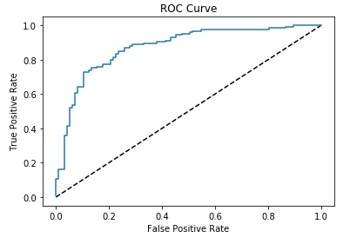
Model: Logistic Regression Model Evaluation
We evaluate the competency of our model using several approaches. For this presentation, we will focus on a confusion matrix and an ROC curve.
True Positive
77 | 20
26 | 99
True Negative
In a confusion matrix, we want to focus on the True Positive Rate and True Negative Rate (the whole numbers are in bold above)
We see that the TPR and TNR are 79%, which is favourable
The greater the area under our ROC curve, the more favourable is our model.
Based on the latter, our model faired well.

Slide 21
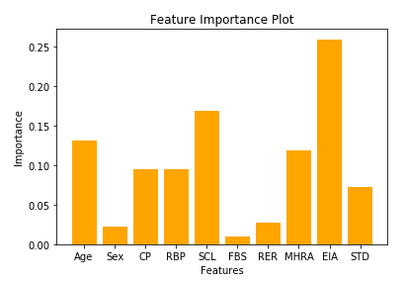
Model: Random Forest Model
To compare our analysis, we used a stronger and more stable model. The coefficients, in terms of feature importance, from this model are below:
Unlike the previous model, a random forest is able to compute each individual feature importance
From the plot, we see that there are three major stand out features
These features are age, serum cholesterol levels and exercise induced angina

Slide 22
Model: Random Forest Model Evaluation
We evaluate the competency of our random forest model by studying the mean squared error (MSE) and the R Score on the training and test sets.
R Score on Training Set | R Score on Test Set
0.88 | 0.3
MSE on the Training Set | MSE on the Test Set
0.172 | 0.03
Our model performed well on the training set but lacked quality in predicting the test set
The MSE was low on both training and test set
MSE decreases on the test set
Our predictions are more stable

Slide 23
Limitations and Recommendations

Slide 24
Limitations
Lack of observations means a lack of variety in analysis and therefore lower confidence in predictions
Many missing values from the dataset
Dataset is 30 years old, lifestyle choices, nutrition and the medical sector has changed since then
Male dominant dataset – analysis might not be applicable to an average female patient
Recommendations
Add more relevant features (variables) to the model
Add more observations and complete patient rows to the analysis
Transform study into a longitudinal one to capture trends and changes over time
Collect more recent data for the analysis

